Slide 1

Microservices in production
a case study
marin.prcela@minus5.hr

Slide 2

1
What are Microservices?
2
Do you need them?
3
How did we do it?

Slide 3



Slide 4
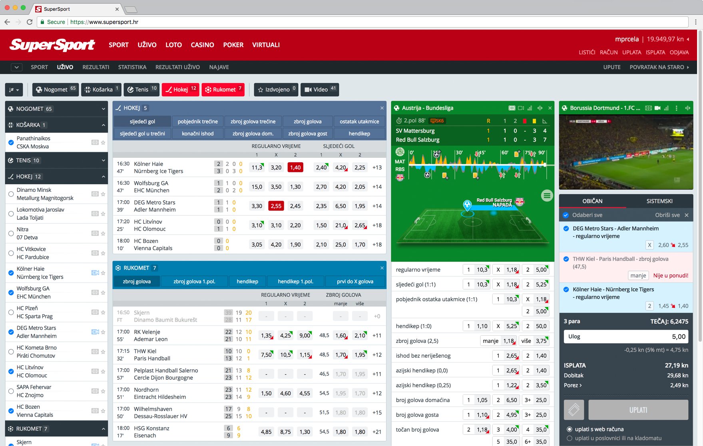

Slide 5
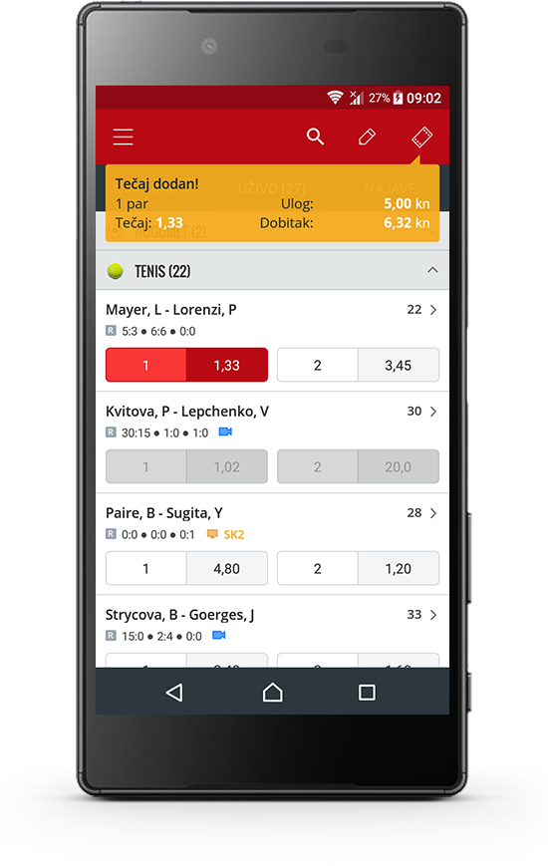
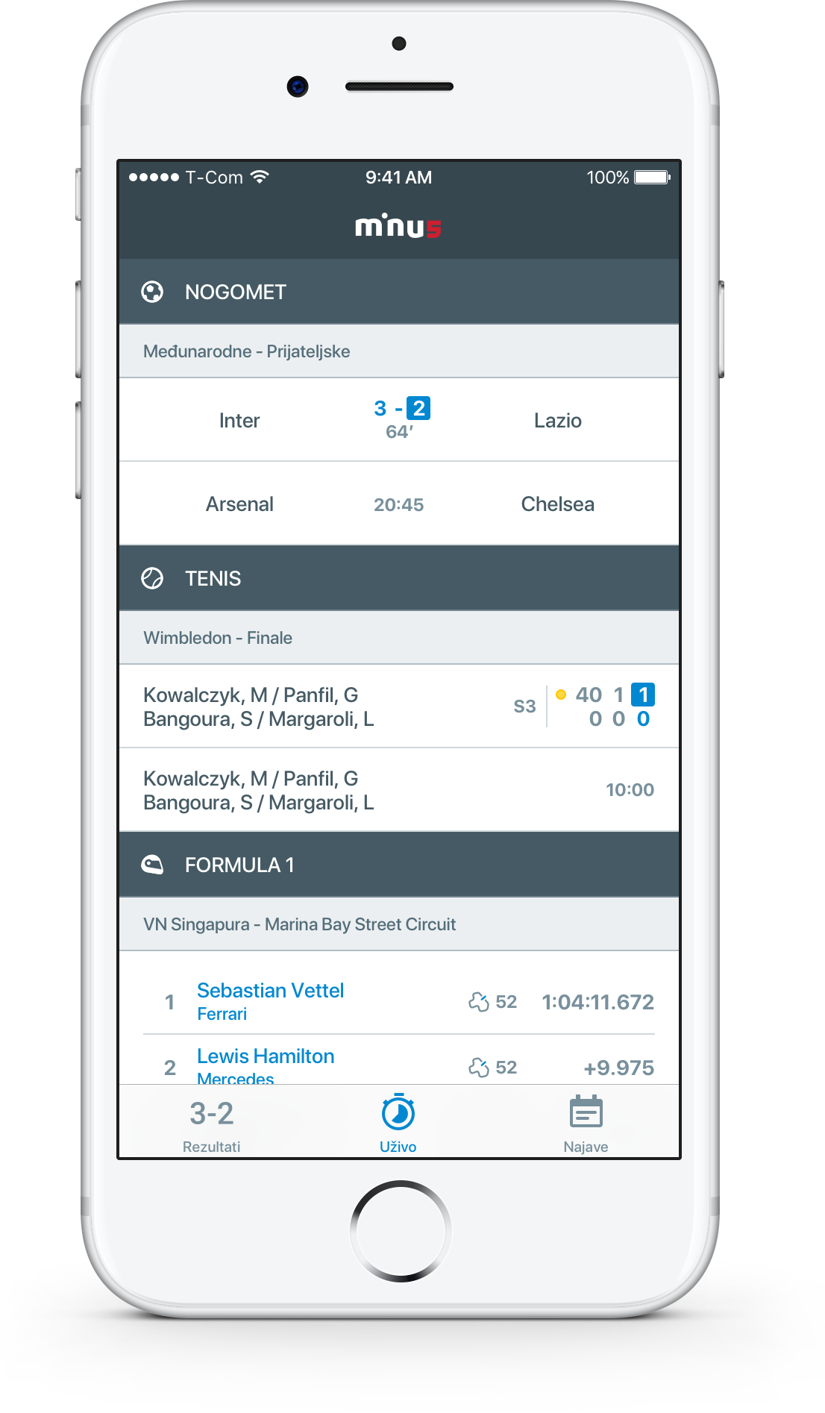

Slide 6
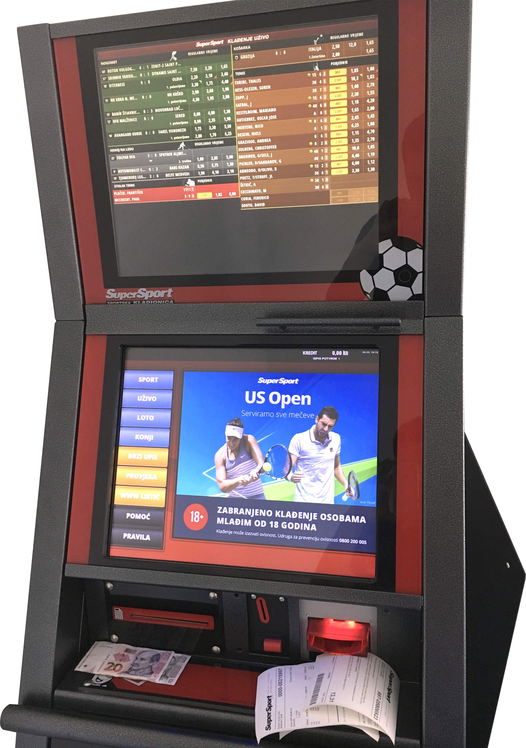

Slide 7
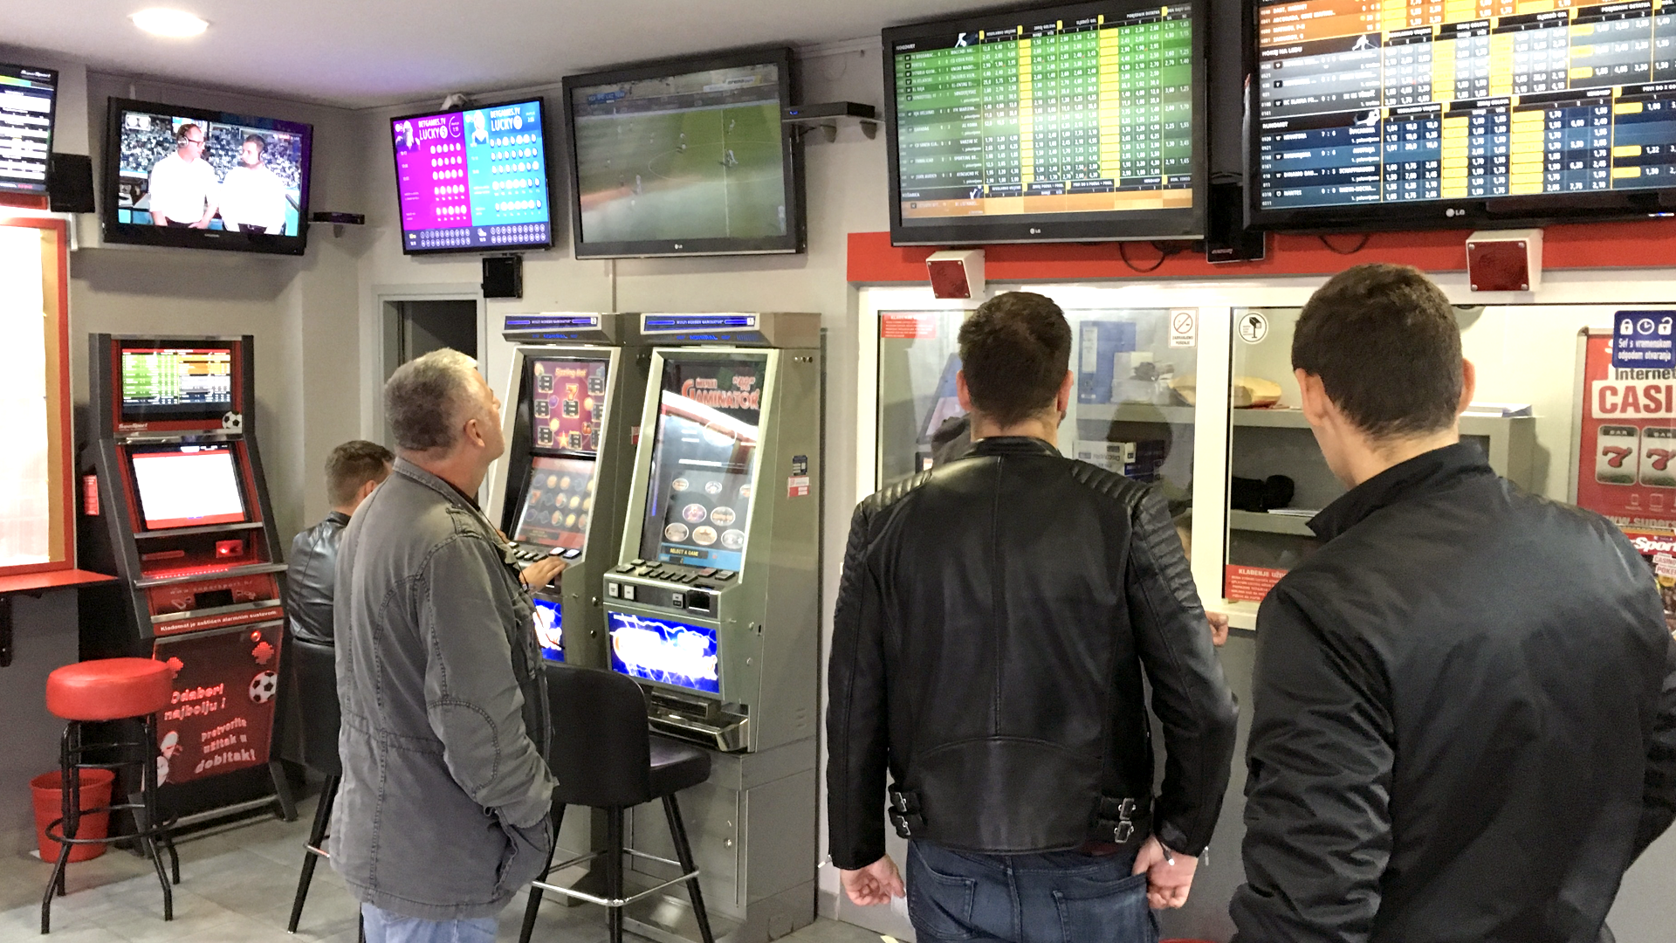

Slide 8
1
What are Microservices?

Slide 9
loosely coupled
business capabilities
enable continuous delivery
evolve technology stack
marin.prcela@minus5.hr

Slide 10
Monolith
Microservices
frontend
frontend
backend
slips
odds
accounts
marin.prcela@minus5.hr

Slide 11
2
Do you need them?

Slide 12
Coupling
Putting network in the middle helps?
Joined data?
marin.prcela@minus5.hr

Slide 13

Hard work

Slide 14
Latency
slip already processed?
odds are
valid?
reserve
money
authorization?
store slip
confirm
money
reservation
marin.prcela@minus5.hr

Slide 15
more Hard work

Slide 16
Scalability
slips
odds
accounts
marin.prcela@minus5.hr

Slide 17
?
Do you need them?

Slide 18
3
How did we do it?

Slide 19

github.com/minus5/examples-services

Slide 20




http://
REST
Messaging
Service Discovery
Containerisation

Slide 21
APP
HTTP
HTTP
SENSOR
WORKER
SENSOR
WORKER
APP
HTTP
HTTP
marin.prcela@minus5.hr

Slide 22
http://
REST
Messaging
Service Discovery
Containerisation

Slide 23
Messaging
SENSOR
WORKER
APP
NSQ
marin.prcela@minus5.hr

Slide 24
Routing
pub/sub
load balancing
… and anti-patterns!
marin.prcela@minus5.hr

Slide 25
Edge cases
stale messages
missed messages
order of receiving
marin.prcela@minus5.hr

Slide 26
again, really?

Slide 27
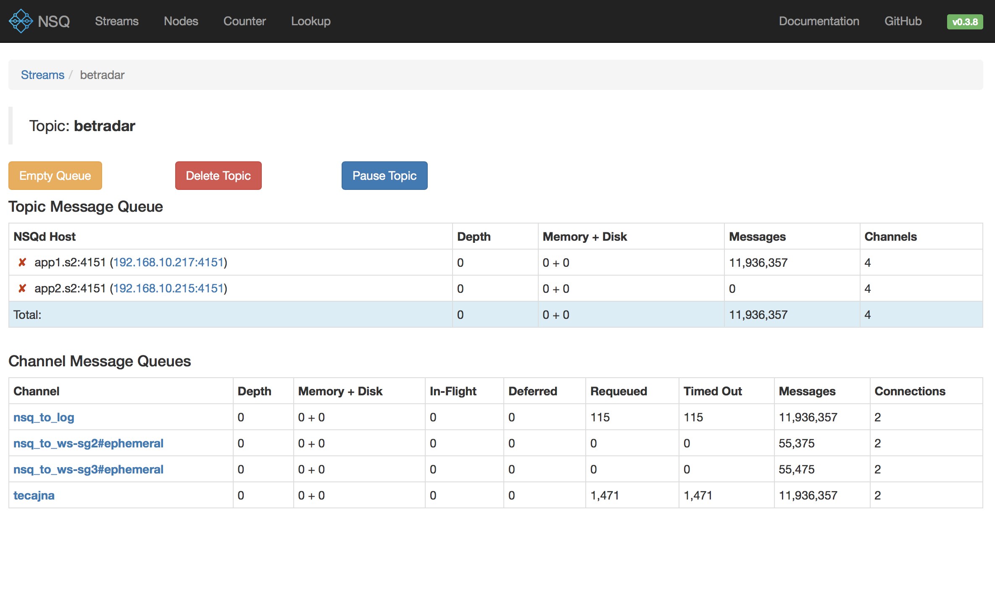

Slide 28
http://
REST
Messaging
Service Discovery
Containerisation

Slide 29
Service discovery
name
location
health check
marin.prcela@minus5.hr

Slide 30
Finding service
setup Consul as DNS
poll Consul with HTTP
events from Consul
render config file
marin.prcela@minus5.hr

Slide 31
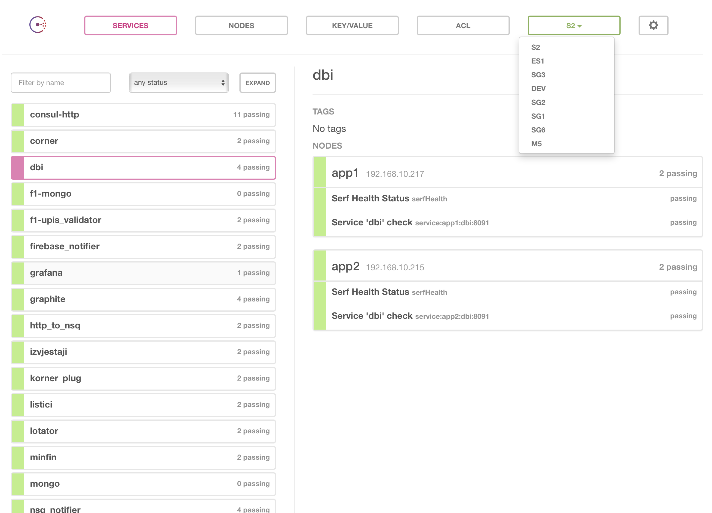

Slide 32

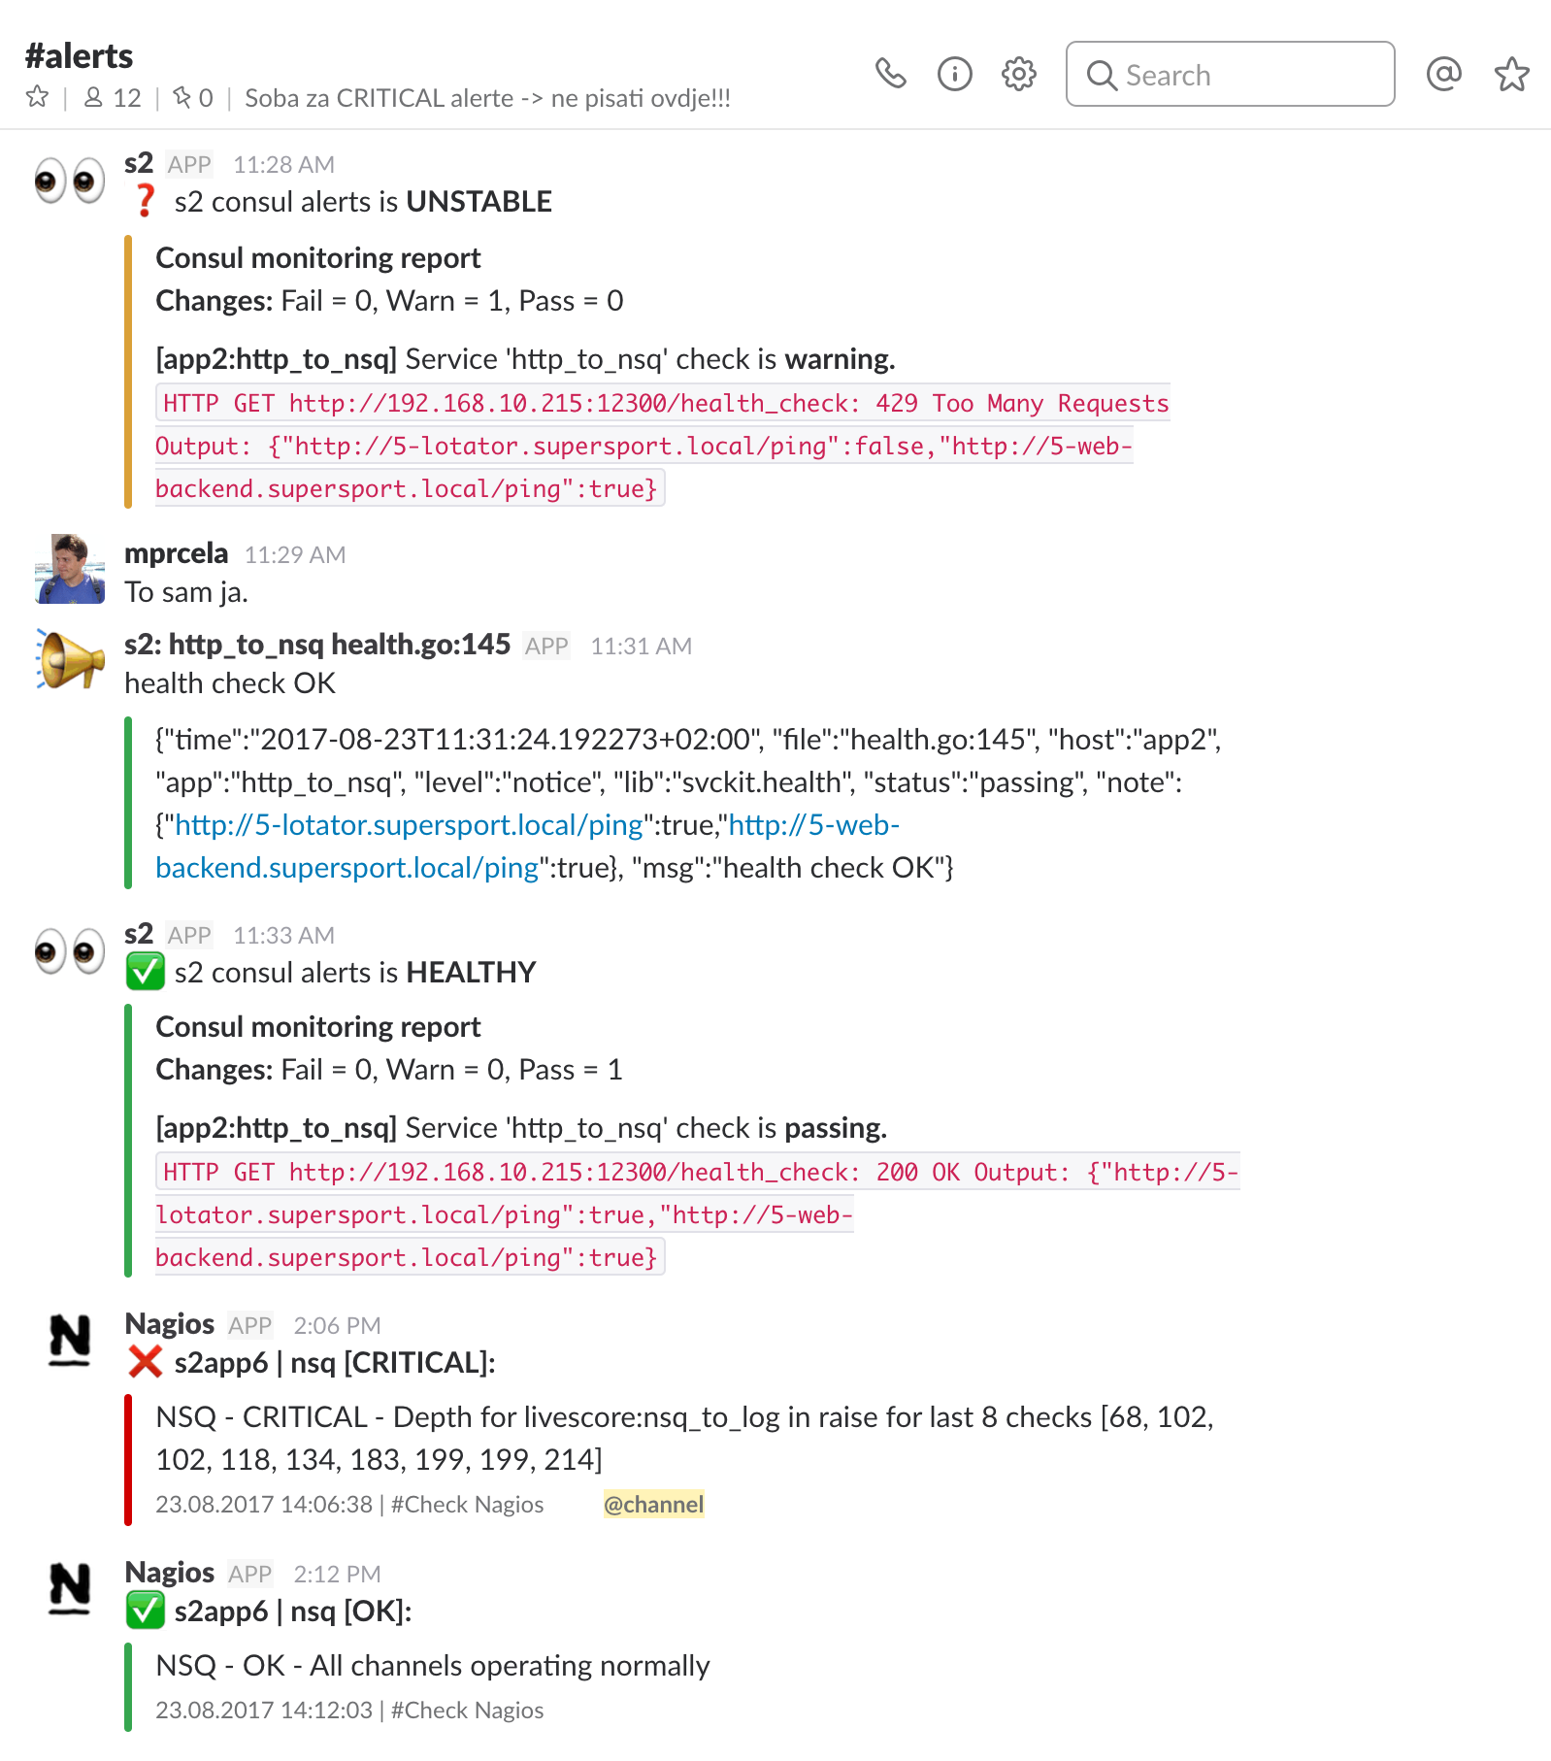

Slide 38
http://
REST
Messaging
Service Discovery
Containerisation

Slide 39
Containerisation
recipe
image
container
marin.prcela@minus5.hr

Slide 40
Benefits
service management
service environment
run on my machine
everything is in the code!
marin.prcela@minus5.hr

Slide 41

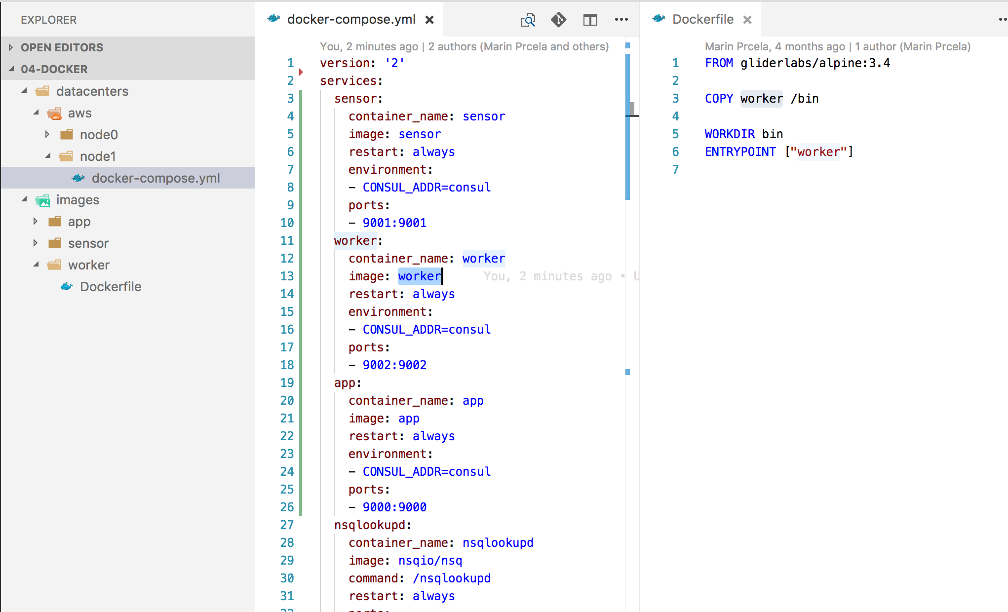

Slide 42
worker
go build
image build
registry
deployer
sensor
app
nsqadmin
logger
nsqadmin
logger
nsqadmin
logger
nsqd
nsqlookupd
nsqd
nsqlookupd
nsqd
nsqlookupd
consul
registrator
consul
registrator
consul
registrator
DEV 01
DEV 02
AWS 01
DEV
datacenter
AWS
datacenter

Slide 43
github.com/minus5/examples-services

Slide 44
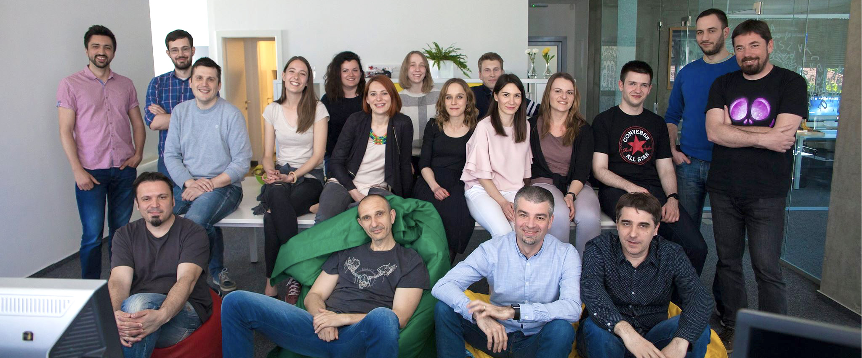

That’s me
posao@minus5.hr
marin.prcela@minus5.hr

